Slide 1
Number of neutrons (n)
Stable Nucleus
Unstable Nucleus
Number of protons (p)

Slide 2
Binding Energy Per Nucleon (in MeV)
Mass number (A)

Slide 3
Nuclear Fission
Binding Energy Per Nucleon (in MeV)
Mass number (A)

Slide 4
Nuclear Fission
Binding Energy Per Nucleon (in MeV)
Mass number (A)

Slide 5
Binding Energy Per Nucleon (in MeV)
Nuclear Fusion
Mass number (A)

Slide 6
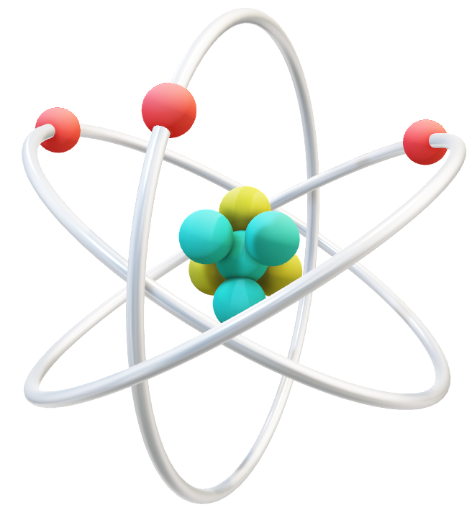


Slide 7
Unstable
Stable
Number of neutron
Stability curve
Number of proton

Slide 8
Unstable
Number of neutron
Stable
Stability curve
Number of proton

Slide 9
Number of neutron
Stable
Unstable
Stability curve
Number of proton

Slide 10
Number of radioactive nuclei
Time

Slide 11
Activity of sample
Time

Slide 12
A
A
B
B₁
B₂
A
B
C

Slide 13
Number of radioactive nuclei of A
Time

Slide 14
Number of radioactive nuclei of B
Time

